Slide 1
Dos and Donts when working in Asia. A comparison based on the example Germany/Austria and Singapore.
Lions Club Wien Johann Strauss
September 23, 2014
Walter Sedlacek

Slide 2
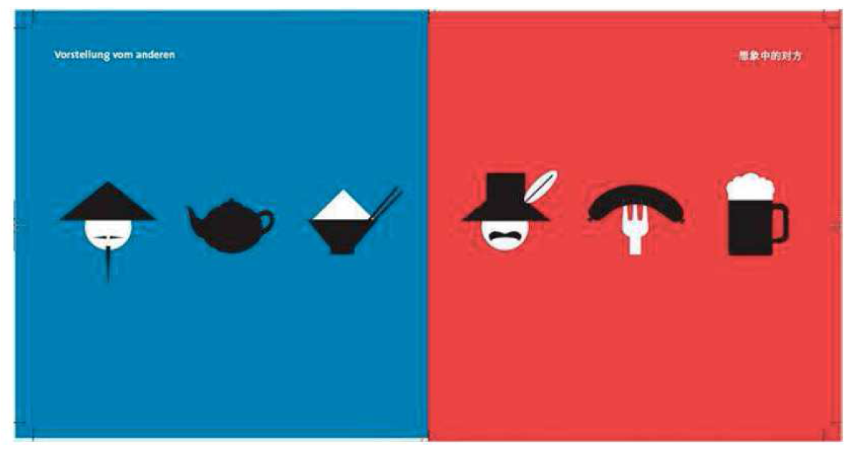
Perception of each other

Slide 3
Perception of each other
We look different
We were brought up different
We have different values
We like different things
We believe in different things
We eat different things
We speak different (language but also usage of words and phrases)

Slide 4
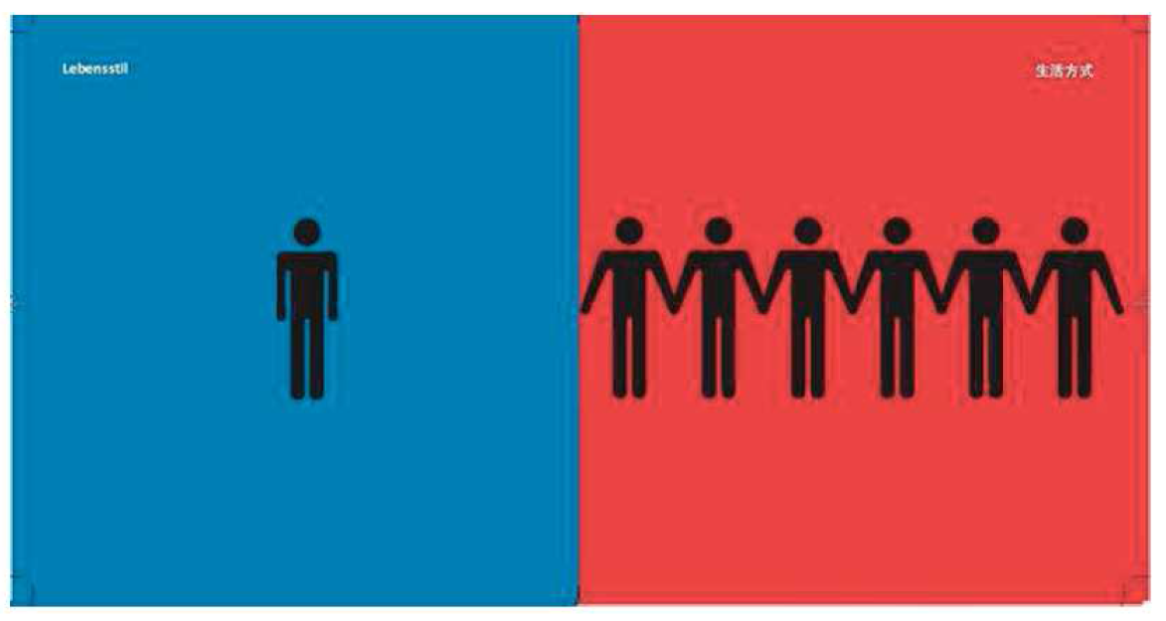
Individualism vs. Collectivism

Slide 5
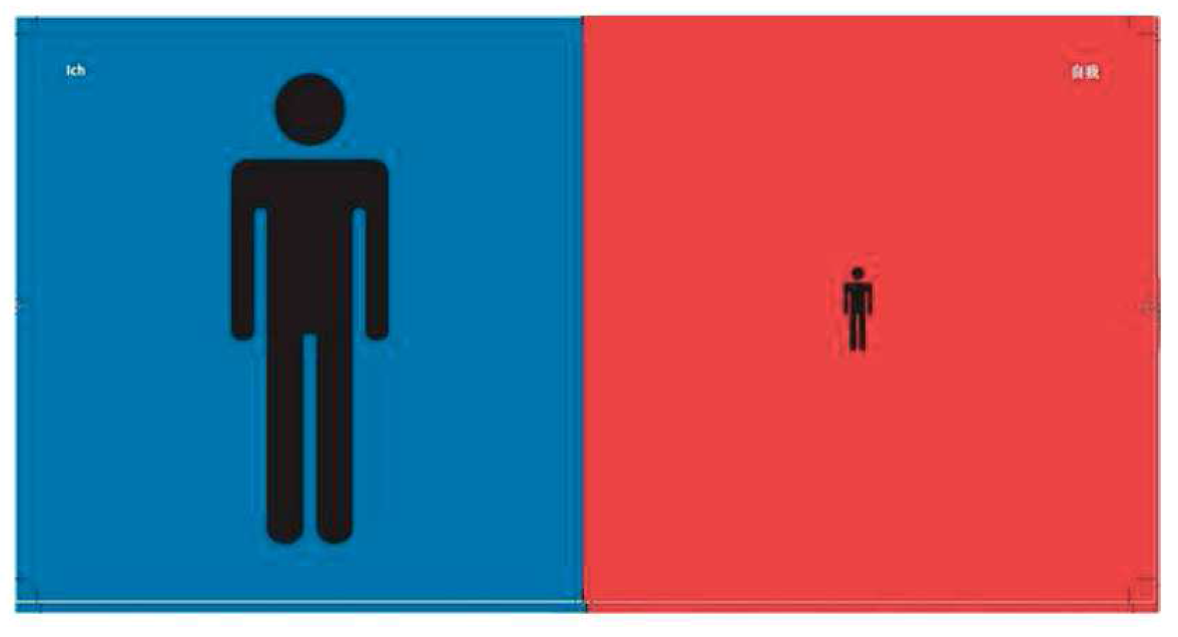
Individualism vs. Collectivism

Slide 6
Individualism vs. Collectivism
Austria / Europe
Singapore / Asia
Focus is on the individual
Sorting things out alone
Kids leave house very early to live on their own.
Strong personality, self-confidence and self-assurance are important personality traits – being self sufficient and able to look after yourself.
Focus is on the group
Sorting things out together
Kids stay with parents until marriage, family bond is strong.
Being humble, loyal and caring are important personality traits – being able to look after the one you love.

Slide 7
HIGH VS. LOW CONTEXT
Austria / Europe
Singapore / Asia
Low context culture – all information must be given in the communication in a structured manner and the context doesn’t provide any additional information.
Austrians might get easily short tempered if not all information is given. They will ask questions until they understand as they don’t like uncertainty.
High context culture – a lot of information might be implicitly clear to all individuals from the situation - except to the foreigners ;)
Singaporeans might wonder why Austrians don’t get all the implicit hints the context provides, ask for so much information and seem to get impatient easily.

Slide 8
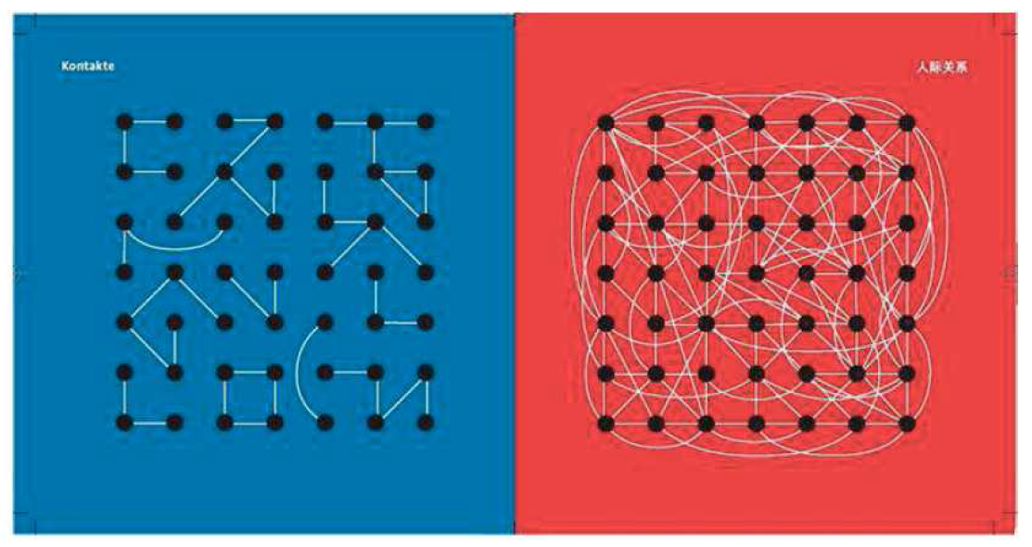
Contacts

Slide 9
Business Communication
Austria / Europe
Singapore / Asia
Mobile phones are silent in meetings.
Business life and private life are strictly separated what you can also see in the way they dress for each part of their life.
Austrians do not fancy small talk, they want to “come to the point”.
Austrians treasure efficiency & structure.
A formal contract has more value than the personal word or relationship.
Calls of important people are taken even in meetings with others – depending on the relation ship so phones are on.
Business life and private life merge and family is very important. Dress Code is less formal in Singapore.
Small talk is important to create an enjoyable atmosphere.
A personal commitment is more important than a written statement.

Slide 10
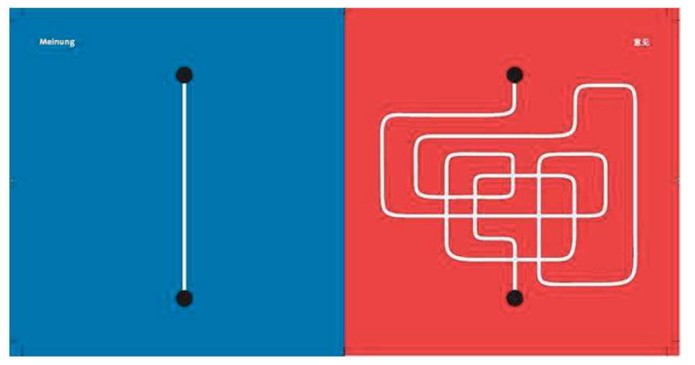
Direct vs. Indirect Communication

Slide 11
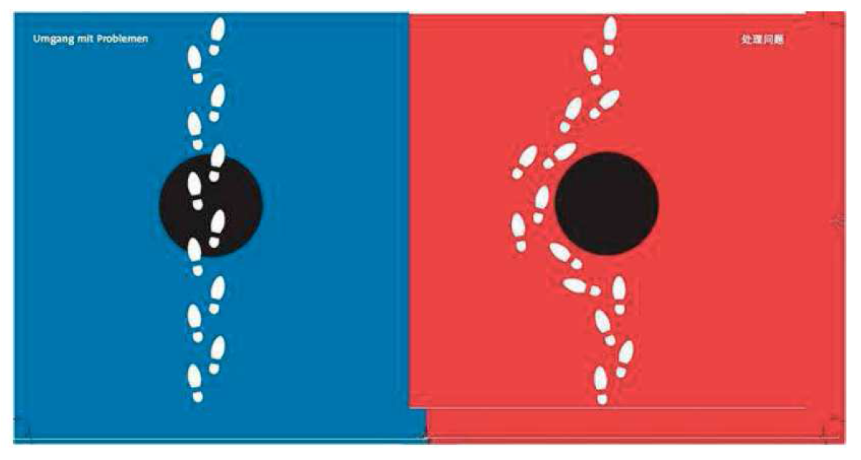
Handling of Problems

Slide 12
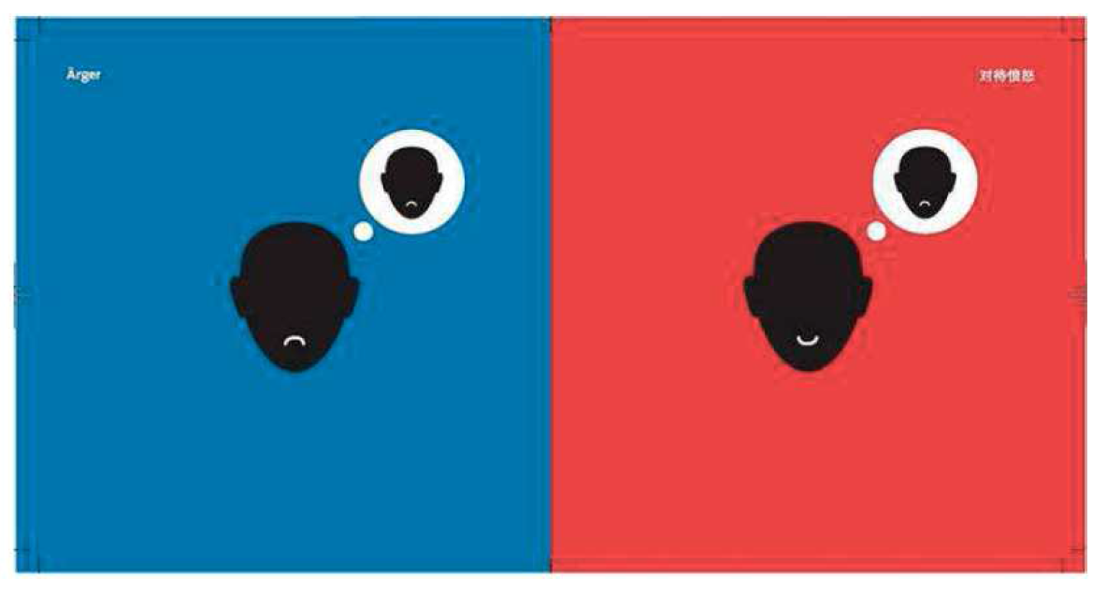
Anger

Slide 13
Direct vs. Indirect Communication
Austria / Europe
Singapore / Asia
Clarity and understanding is prime goal.
Information needs to be structured!
Direct and honest communication is seen as sign for honesty and sincerity.
Eye contact is important.
Compliments are very rare.
Feedback about a topic is very direct and highly appreciated – no matter if positive or negative.
Losing face doesn’t exist because “no” to a topic is “no” to a topic – not to the person!
Yes and nodding means: yes, we do it!
If an Austrian is angry – you will see it in his face!
Making or keeping a good relationship is key
Relationships are very important and people would not like to jeopardize a relationship so critical feedback would usually be avoided or more indirect.
Eye contact is not as important and staring at someone can be seen as very impolite.
Compliments and nice small talk are important for a good atmosphere.
“No” to a topic could be seen as “no” to the person so it would be usually avoided in order not to make someone lose face.
Yes and nodding means: I listen to you.
You don’t necessarily see if someone is angry as the facial expression might still be nice and friendly.

Slide 14
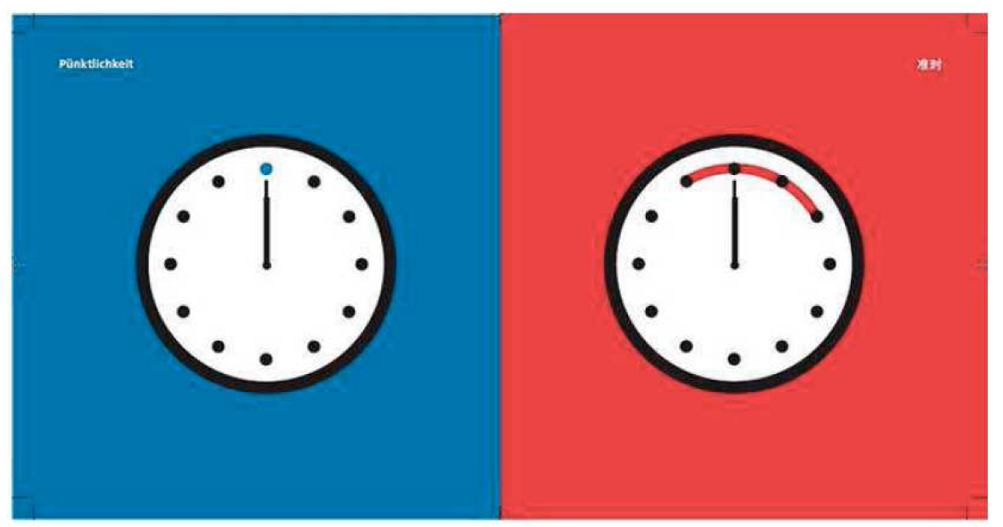
Time Concept

Slide 15
Time concept
Austria / Europe
Singapore / Asia
Austrians follow a very strict linear time concept what means that they prefer to do things one by one
Austrians would want to have a very clear schedule and agenda and prefer to have the topics as planned
Distractions and interruptions are not appreciated
Deliverables should arrive within the deadline
People should be on time
Austrians love efficiency so they expect people to come to meetings prepared (with material, information, slides, documents etc.) and will do so as well
Time is dealt with in a non-linear fashion – things are done according to priority or relationship to the requestor. Time concept is not as strict as for western people.
A strict schedule is not necessary and can be experienced as too rigid and not allowing enough flexibility to deal with the situation or the topics arising from the discussions.
Distractions and interruptions are ok and are dealt with according to priority of the person
Singaporeans also love efficiency but that doesn’t mean they come with slides and presentation material to the meeting. They prefer to allow flexibility and discussion time.

Slide 16
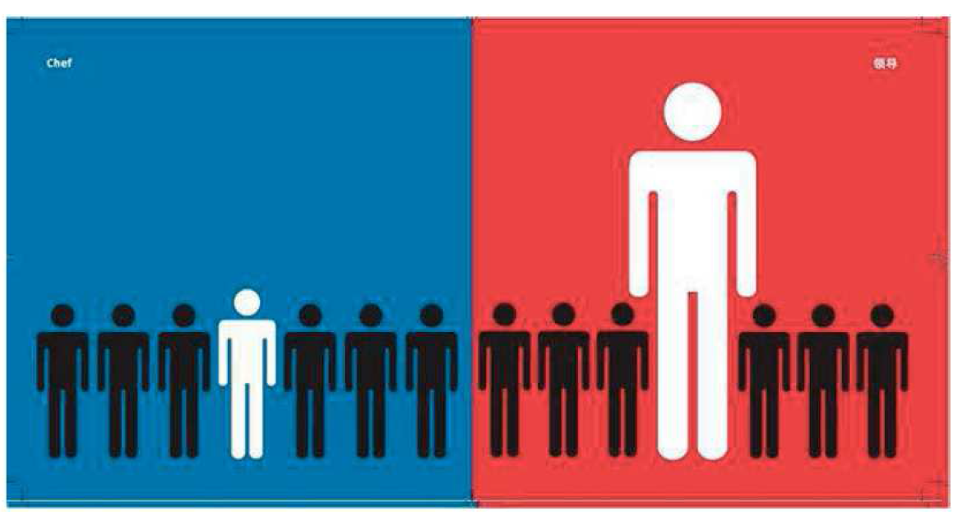
Power and Hierarchy – The boss

Slide 17
Power and Hierarchy
Austria / Europe
Singapore / Asia
What counts for people in order to respect others is their competency and personality more than status, title and hierarchy.
A manager is not necessarily the highest expert of his team but still has the authority to manage.
Managers proactively ask for the opinion and expertise of their employees and value it – without consideration of hierarchy.
Meeting tables are usually round with no specific seating for hierarchy.
A certain understatement is appreciated in Germany with regards to status, brands, titles etc.
Status and rank are very important and are valued.
A manager is expected to have the final saying in decisions and have answers for the team and would be an expert in these matters.
It might be more difficult to voice out a critical opinion against someone of a higher hierarchical status.
The seating at a table might indicate the status of the person.
Success is publicly shown (desginer brands, cars, houses)
Titles can make a difference in the business life and are considered very important.

Slide 18
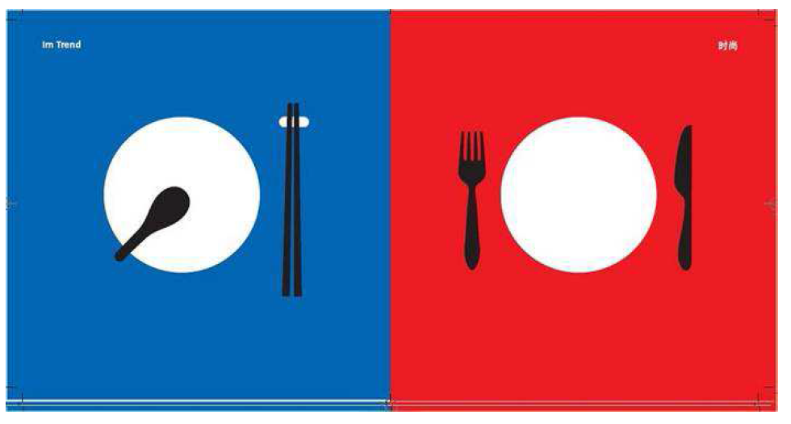
What's Trendy

Slide 19
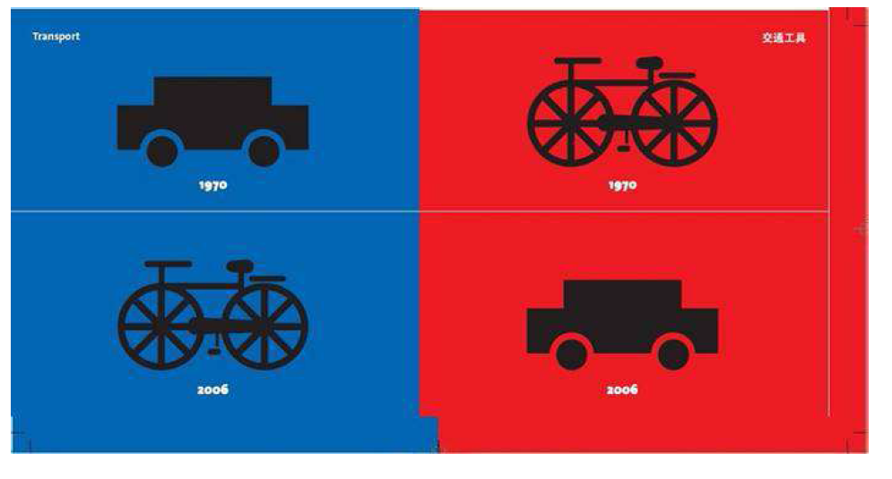
Transportation

Slide 20
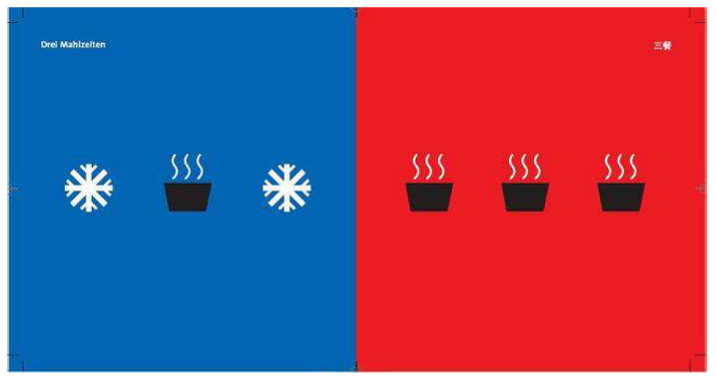
Three meals a day

Slide 21
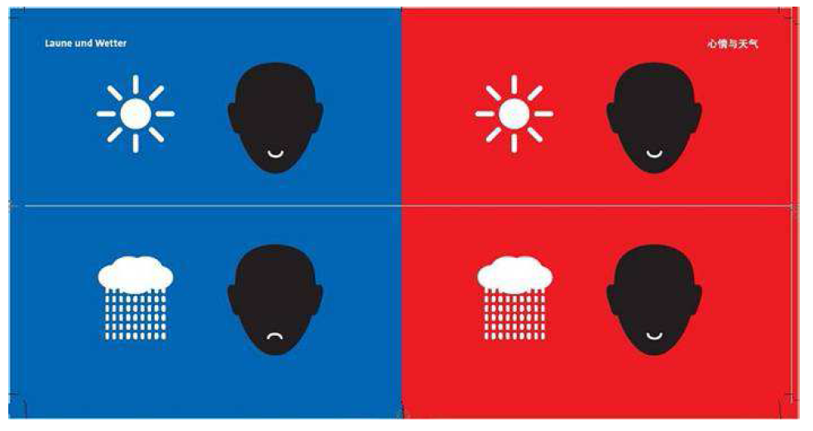
Moods and Weather

Slide 22
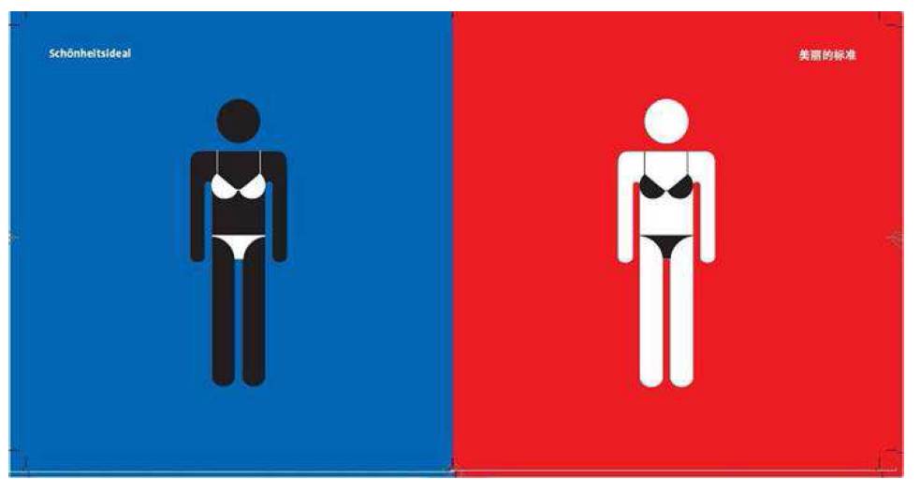
Last but not least: Beauty

